Slide 1
Lesson 1: Introduction to transcriptomics
Matteo Dugo, PhD
IRCCS Ospedale San Raffaele
Department of Medical Oncology – Breast Cancer Unit
Clinical translational and immunotherapy research

Slide 2
Outline
High-throughput technologies to measure RNA expression
Microarray
RNA-Sequencing
Experimental design for transcriptomics
General considerations
Technology-specific considerations
What can we do with transcriptomics data?
Examples of applications

Slide 3
Why measure gene expression?
Assumption: the functional state of a cell is largely dependent on which genes are expressed
Transcriptomics technologies are the techniques used to study an organism's transcriptome
Transcriptomics captures a snapshot in time of the total transcripts present in a cell.
Measuring the expression of an organism's genes in different tissues, conditions, or time points gives information on how genes are regulated and reveals details of an organism's or cell’s biology.
An analysis of gene expression in its entirety allows detection of broad coordinated trends which cannot be discerned by more targeted assays.

Slide 4
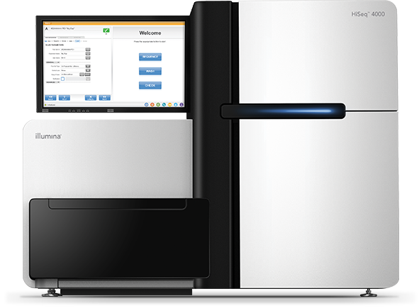
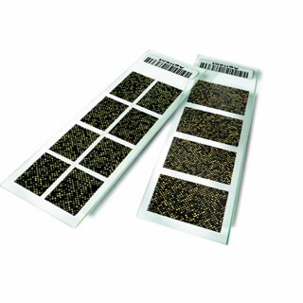
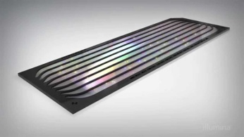
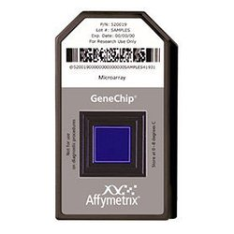
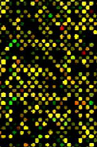
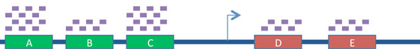
Two major approaches
DNA Microarrays
Isolate mRNA from cells
Solid support with “probes” specifically targeting each gene
Label your mRNA and hybridyze to array
Quantify how much mRNA bound to each probe
Next-Generation Sequencing (RNA-Seq)
Isolate mRNA from cells
Sequence the entire pool of mRNA
Quantify how many sequences come from each gene

Slide 5
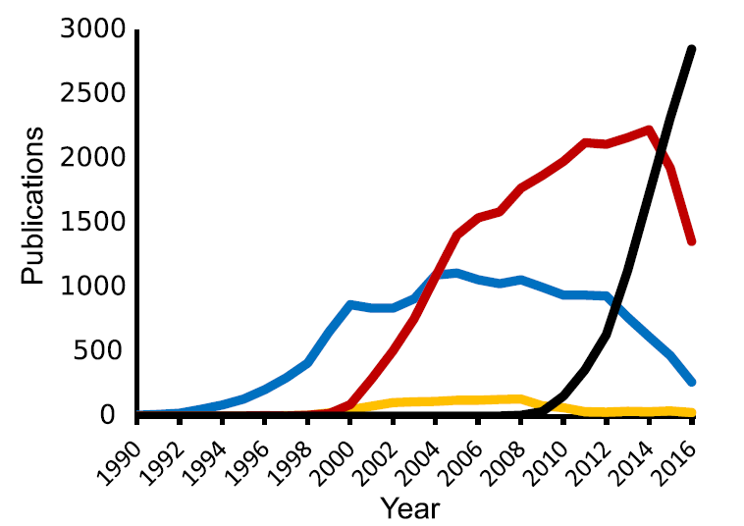
Transcriptomic methods used over time
SAGE
EST
Microarray
RNA-Seq
Lowe R et al. PLoS Comput Biol. 2017

Slide 6
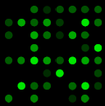
Microarray: general principle
Sample
X coordinate | Y coordinate | Expression
x₇ | y₇ | 3
x₇ | y₈ | 2
x₈ | y₇ | 1
x₈ | y₇ | 0
RNA extraction and labeling with fluorescent dye
Image scan
Hybridization
y₇
y
x
y₈
x₇
x₈

Slide 7
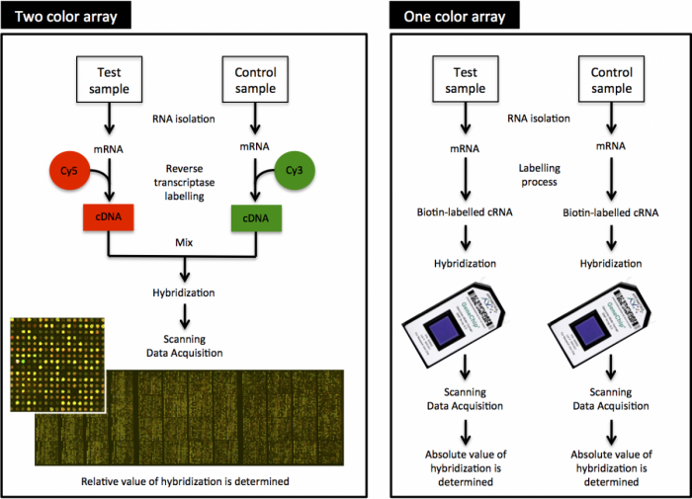
Type of microarrays

Slide 8
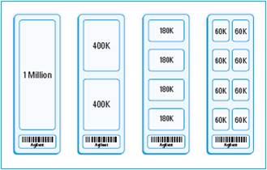
Contemporary microarrays: one-color arrays
Two microarray platforms are commercially available :
Affymetrix (now Thermo Fisher)
Clariom S: gene-level view of the human transcriptome
Clariom D: confidently detect genes, exons, and alternative splicing events that give rise to coding RNA and lncRNA isoforms.
FFPE compatible
Agilent SurePrint G3 Gene Expression Microarrays
Gene level and exon-level arrays

Slide 9
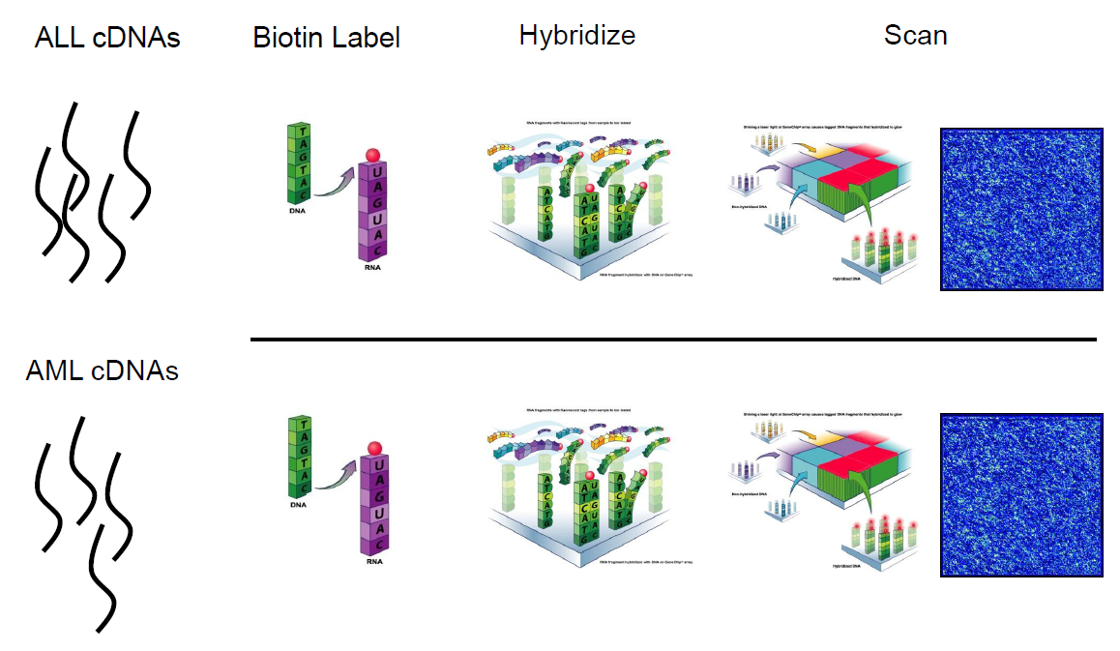
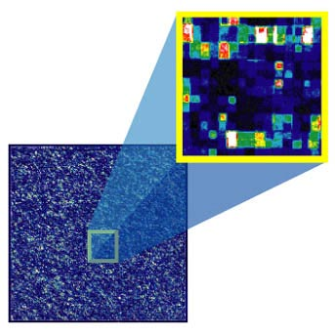
Affymetrix Clariom microarrays
ALL
AML

Slide 10
Preprocessing of microarray data
Pre-processing typically constitutes the initial (and possibly most important) step in the analysis of data from any microarray experiment
• Consists of:
Quality Assessment
Background correction, normalization, summarization
• These are interlinked steps
Outliers removal
Raw data
Quality control
Bkg correction, normalization
Quality control
Outliers?
Filtering and collapse
Processed data
No
Yes

Slide 11
Preprocessing - Normalization
Variability in gene expression can be either:
Biological - variations that we are interested in (Signal)
Treatment
Tumor subtypes
Different tissue types
Technical - variations that we are not interested in (Noise)
RNA-quality
Hybridization efficiency
Sequencing lane
Operators
Individual heterogeneity
Normalization is a term used to describe a collection of methods which try to eliminate the unwanted variations between sample expression values while retaining the variation that we are interested in.

Slide 12

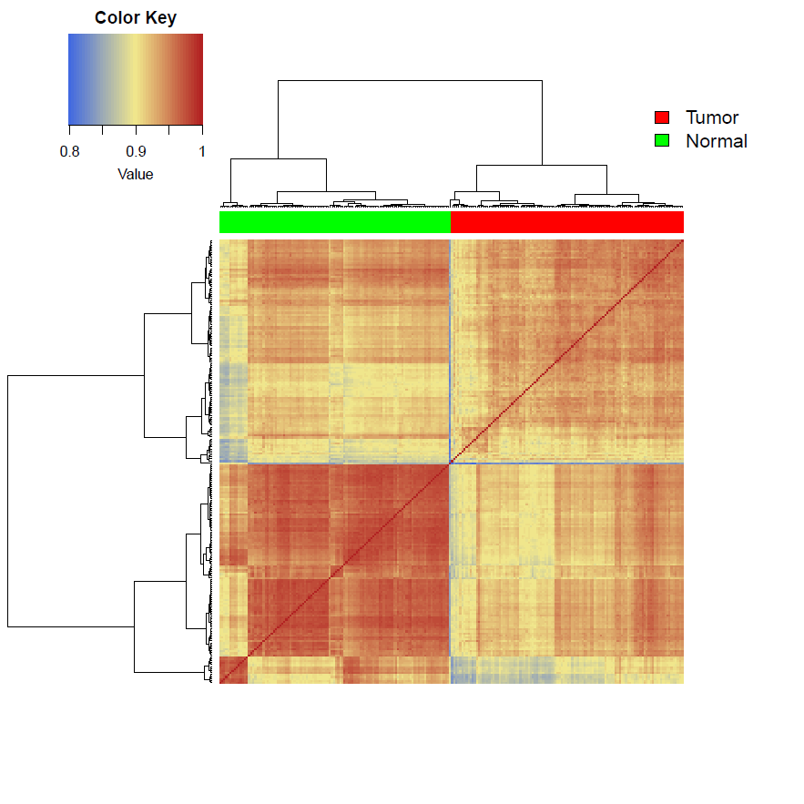
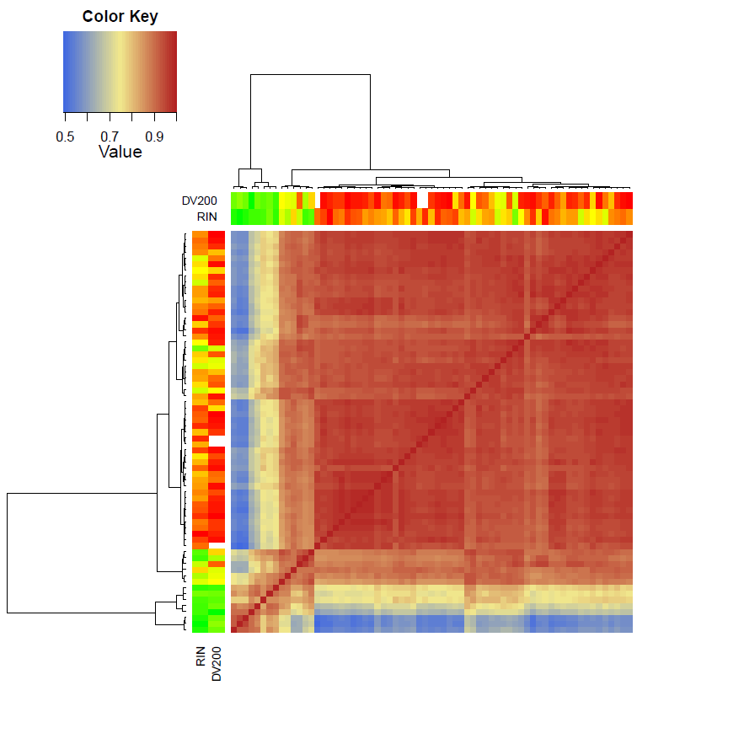
Biological vs technical variability

Slide 13
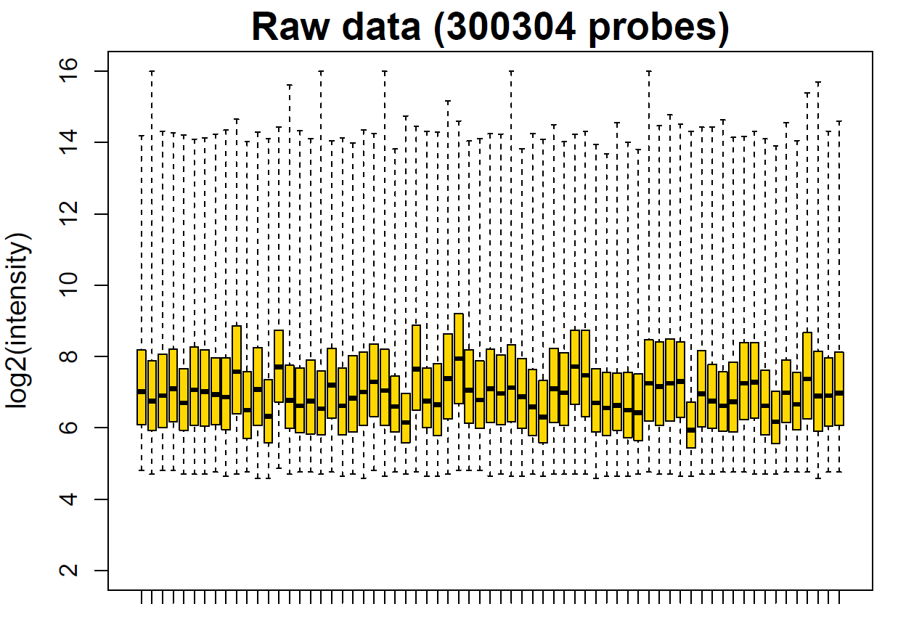
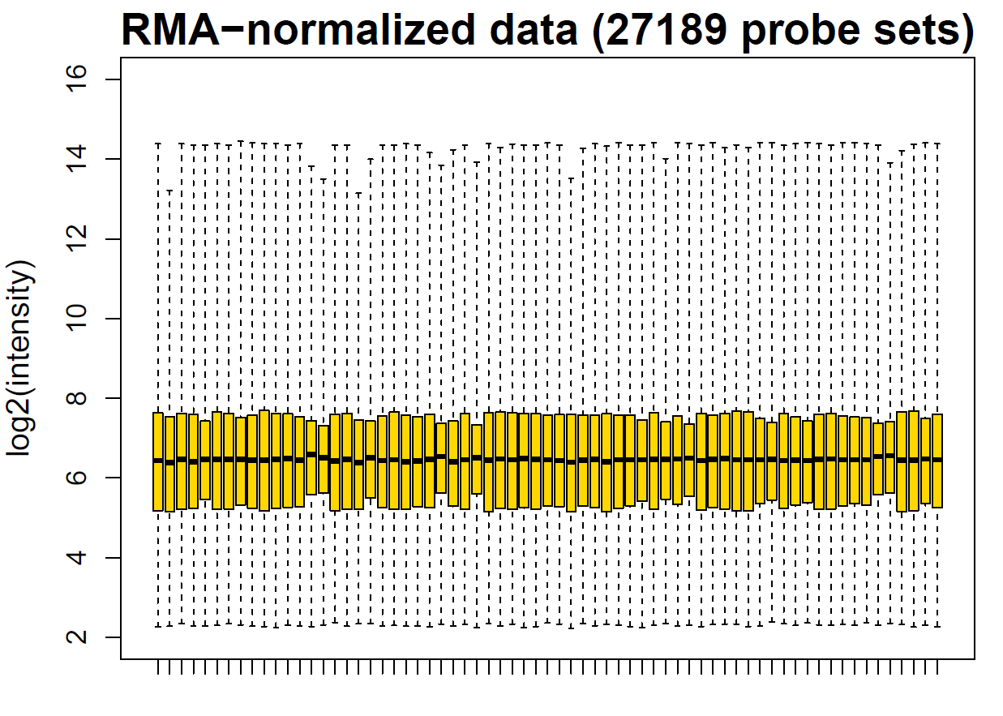
Preprocessing - Normalization
Different normalization algorithm according to the technology and vendor (Agilent microarrays, Affymetrix microarrays, RNA-Seq)
ASSUMPTIONS
Most genes are not differentially expressed
Similar number of up- and down-regulated genes
Raw data
Normalized data

Slide 14
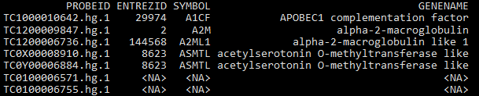
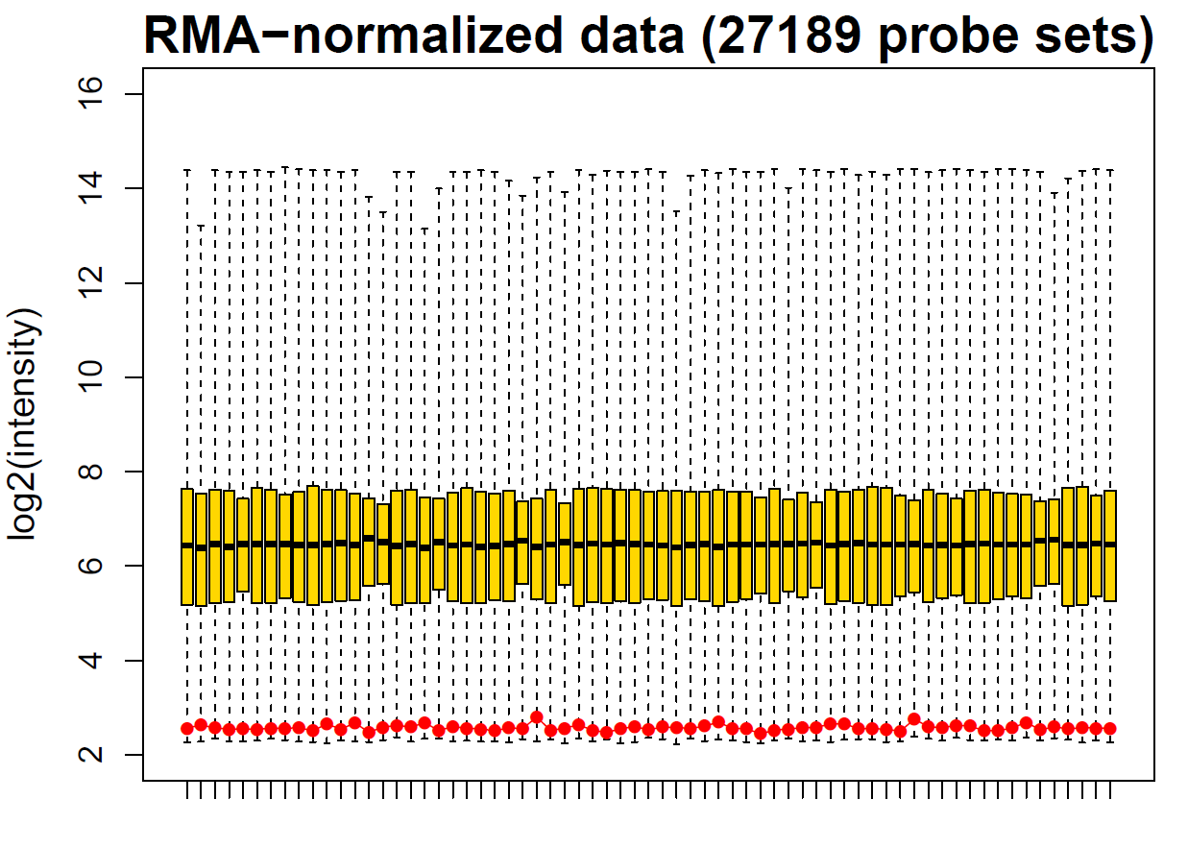
Annotation & Filtering
ANNOTATION
Goal - associate probe sets to genes for downstream interpretation
FILTERING
Goal - removal of uninformative probe sets to reduce noise.
Filtering MUST BE UNSUPERVISED
Example criteria:
unannotated probe sets
low variance across samples
low expression across samples

Slide 15
RNA-Seq – an ensemble of techniques
Total RNA Sequencing
Measure gene and transcript abundance for coding and noncoding RNA
mRNA Sequencing
Measure gene and transcript abundance for the coding transcriptome
RNA exome capture sequencing
Measure abundance for the RNA exome using sequence-specific capture of RNA coding regions.
FFPE or low sample input
Ultra-Low-Input and Single Cell RNA-Seq
Small RNA sequencing
The choice depends on the GOAL OF THE PROJECT

Slide 16
RNA-Seq – Application
Discovery
Transcripts
Isoforms
Splice junctions
Fusion genes
Differential expression
Gene level expression changes
Relative isoform abundance
Splicing patterns
Variant calling
Expression of mutated genes
Allele-specific expression
Neo-epitope identification

Slide 17
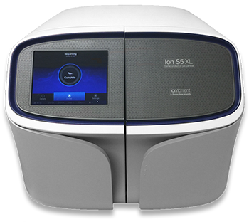
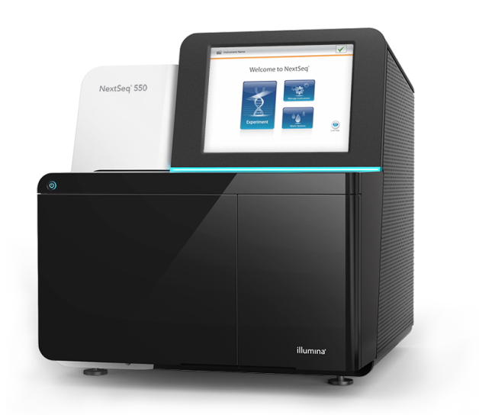
RNA-Seq platforms
Thermo Fisher
Illumina

Slide 18
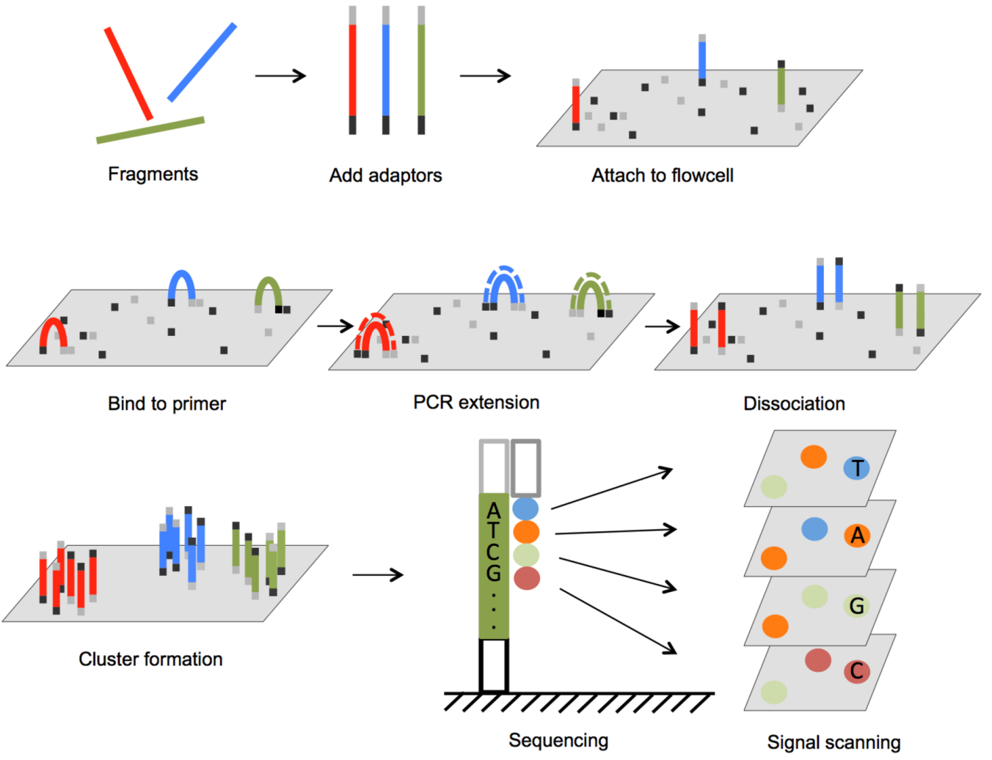
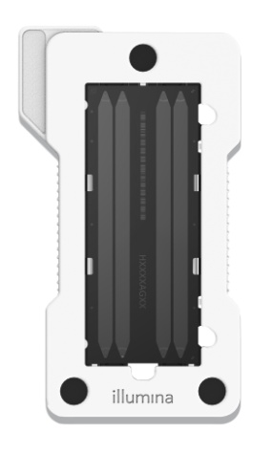
RNA-Seq – principle of Illumina sequencing
Flowcell with four lanes

Slide 19
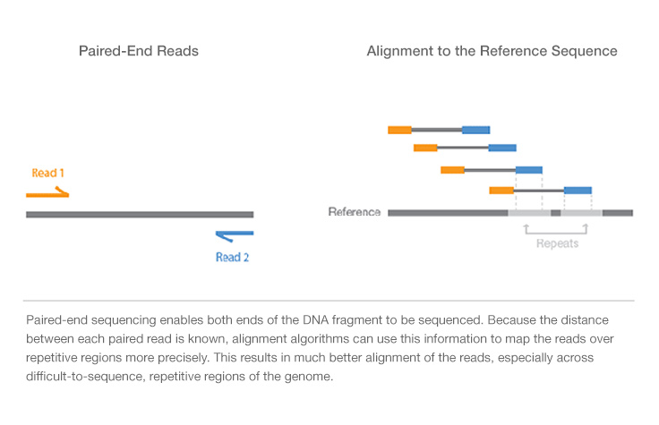
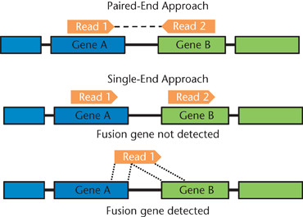
RNA-Seq – single-end vs paired-end reads
Single-End Reads
Paired-End Reads
Alignment to Reference Sequence
Paired-end sequencing enables both ends of DNA fragments to be sequenced.
The distance between each paired read is known enabling better alignment of the reads, especially across repetitive regions.
Essential for gene fusion detection and alternative splicing analysis

Slide 20
RNA-Seq – how deep?
For RNA-Seq, READ DEPTH is typically used instead of coverage.
Read depth varies depending on the goals of the RNA-Seq study.
5 - 25 Million reads per sample
gene expression profiling of highly expressed genes
high multiplexing of samples
30 - 60 million reads per sample
global view of gene expression
some information on alternative splicing
possibility to detect fusions
most published RNA-Seq experiments for mRNA/whole transcriptome sequencing
100 - 200 million reads per sample
in-depth view of the transcriptome
a few samples across several high output sequencing lanes.
More info at https://support.illumina.com/bulletins/2017/04/considerations-for-rna-seq-read-length-and-coverage-.html

Slide 21
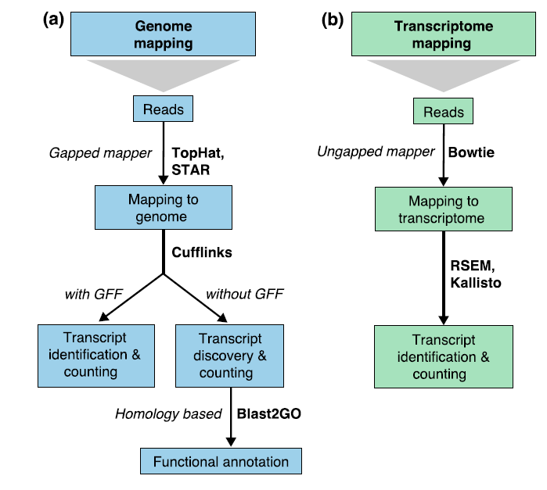
RNA-Seq analysis pipeline
Differential expression
Gene fusions
Splicing analysis
Gene-level differential expression
Conesa et al. Genome Biology. 2016

Slide 22
RNA-Seq analysis – file formats

Slide 23
RNA-Seq analysis – file formats
FASTQ: raw output of unaligned sequences (reads) generated from NGS machines
A sequence in FASTQ format consists of:
Phred score (Q):
Probability that the base is incorrect.
Q = -10*log10(p)
Q10 = 1/10 = 0.1
Q20 =1/100 = 0.01
Q30 = 1/1000 = 0.001
Encoded in ASCII to save space (and file size)

Slide 24
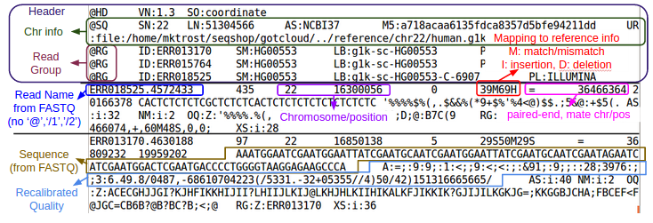
RNA-Seq analysis – file formats
SAM (Sequence Alignment Map) is a text-based file containing reads aligned to a reference geneome/transcriptome
BAM (Binary Alignment Map) is the compressed version of SAM
FASTQ (Unaligned reads) → BAM or SAM (Aligned reads)
Sequence + quality → Sequence + location

Slide 25
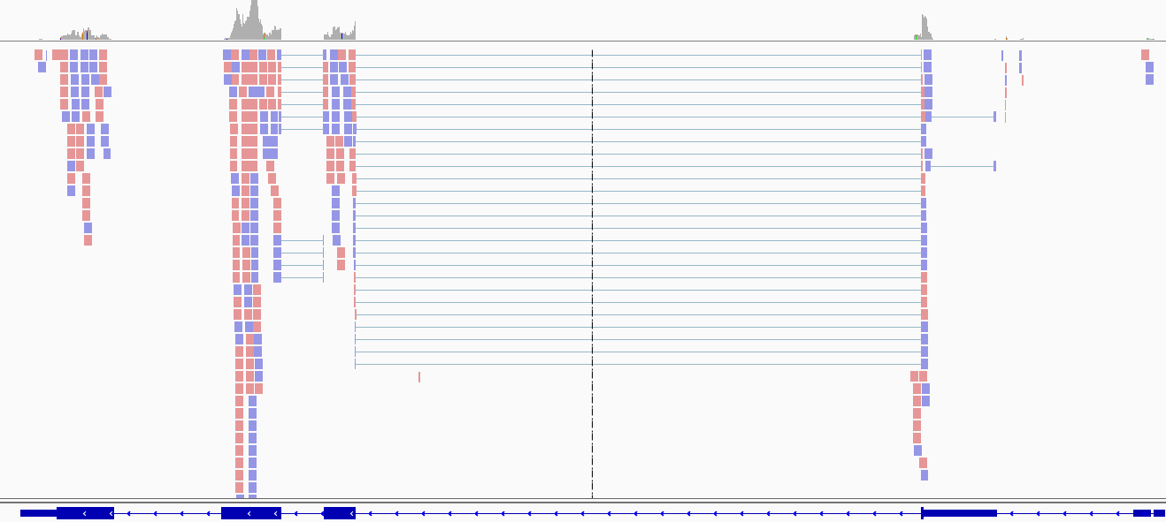
RNA-Seq analysis – feature counting
The abundance of gene or single exons is estimated by counting the number of reads overlapping their chromosomal regions.
Popular tools:
HTSeq-Count (Unix)
Cufflinks (Unix)
Subread (R)

Slide 26
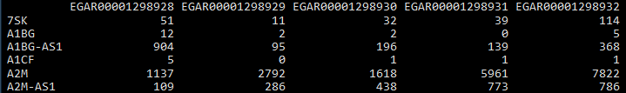
RNA-Seq analysis – expression units
RNA-Seq expression units:
Counts
Counts per million mapped reads (CPM)
Transcripts per million (TPM)
Reads/Fragment per kilobase per million reads mapped (RPKM/FPKM)
not comparable WITHIN a sample without adjusting for the feature length
not comparable BETWEEN samples without normalization across experiments
Allows for comparison WITHIN a sample
https://haroldpimentel.wordpress.com/2014/05/08/what-the-fpkm-a-review-rna-seq-expression-units/

Slide 27
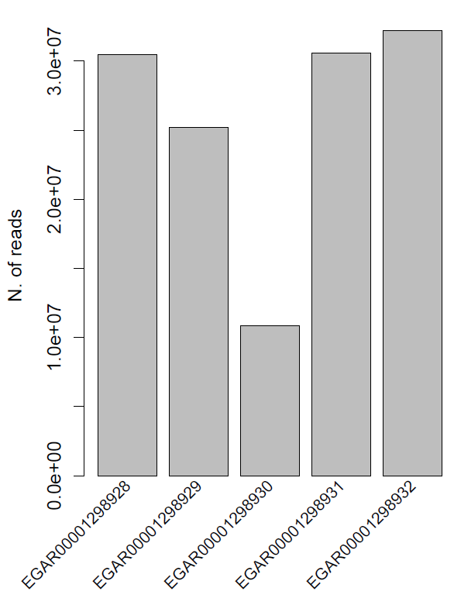
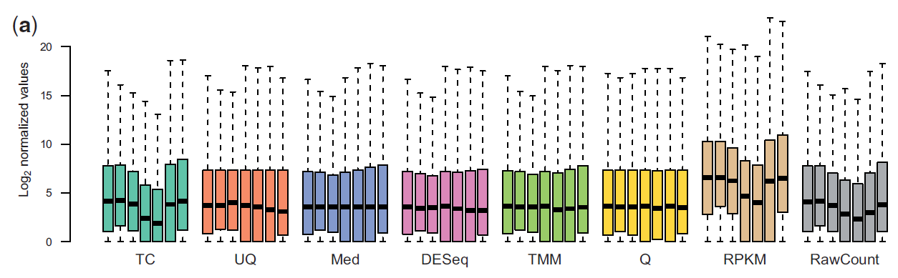
RNA-Seq analysis – Normalization
Within-sample gene-specific effects:
gene length
GC content
Between-sample differences:
library size (i.e. sequencing depth)
Several methods:
Total count
Upper Quartile
Median
Trimmed Mean of M-values (TMM)
Quantile
RPKM
Dillies et al. Brief Bioinform. 2013

Slide 28
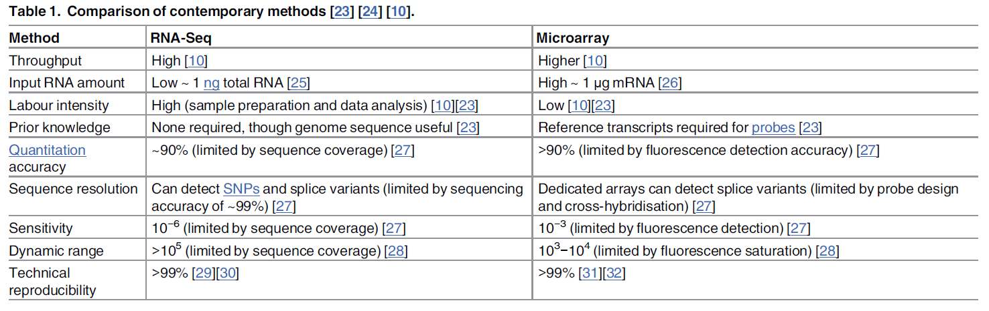

RNA-Seq vs Microarrays
Lowe R et al. PLoS Comput Biol. 2017
”The relationship is not quite linear…but the vast majority of the expression values are similar between the methods. Scatter increases at low expression…as background correction methods for arrays are complicated when signal levels approach noise levels. Similarly, RNASeq is a sampling method and stochastic events become a source of error in the quantification of rare transcripts ”

Slide 29
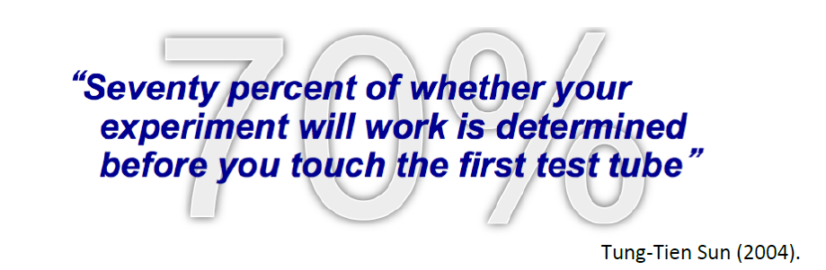
Experimental design
Three fundamental experimental design principles:
Replication - having more samples, in general, reduces variability, giving you a more precise answer to your experimental question
Randomisation – assign samples to treatments randomly helps to protect from bias in the results
Blocking - using a homogenous group of experimental units allow your results to be more reproducible.

Slide 30
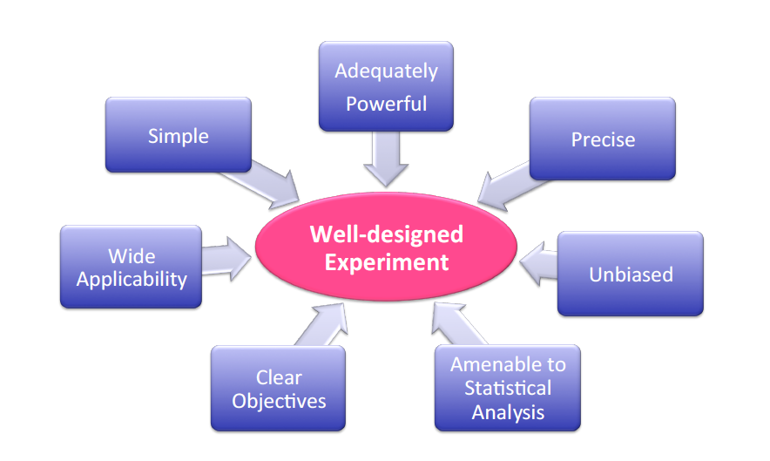
Experimental design

Slide 31
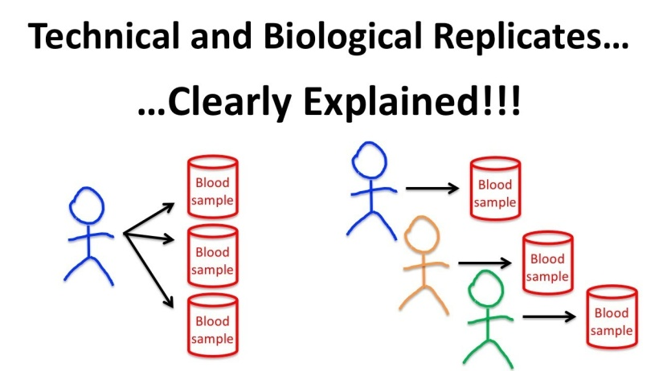
Experimental design – how many samples?
POWER: the probability of detecting an effect of a specified size if present.
SAMPLES: biological replicates, not technical replicates.
Parameters to be known:
Significance level
Effect size
The smaller the effect you want to detect, the greater the number of samples required to have enough power
Dispersion
Higher variability requires higher number of samples to have enough power
Total number of genes being tested
Number of expected differentially expressed genes
Should consider attrition (samples withdrawn from the study or excluded from the analyses)

Slide 32
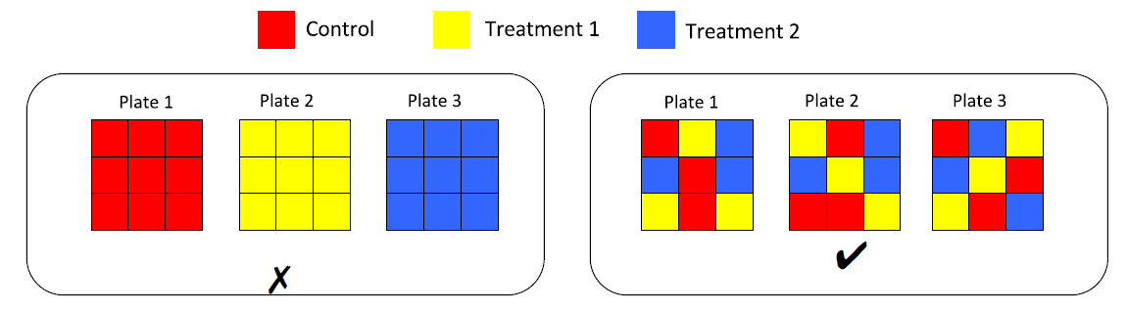
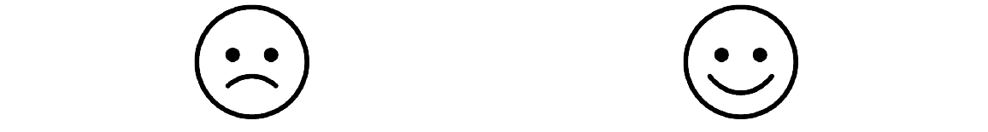
Experimental design – avoid technical confounding
Blocking – arranging of experimental units in groups (blocks) that are similar to one another
Avoid confounding between the variable of interest and technical variables.

Slide 33
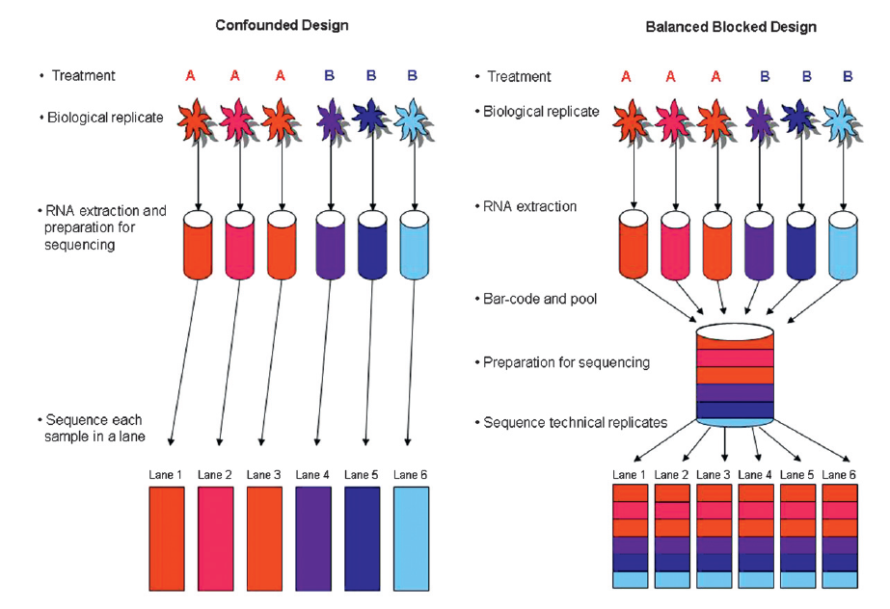
Experimental design – avoid technical confounding
Example of blocking for an RNA-Seq experiment

Slide 34
Experimental design – avoid confounding factors
FALSE ASSOCIATION
Cause:
Drinking coffee
(independent variable)
Effect/outcome:
Lung cancer
(dependent variable)
Other factor:
Smoking
(confounding variable)

Slide 35
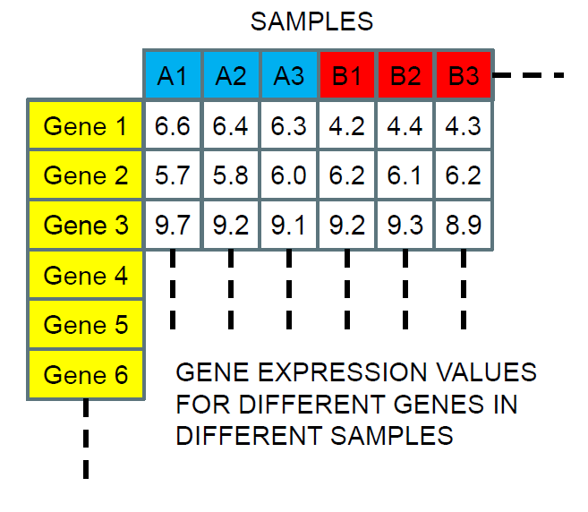
Finally...the expression matrix
Microarray and RNA-Seq eventually produce a gene expression matrix
Gene expression values for different genes in different samples

Slide 36
What can we do with the expression matrix?
Class dicovery
Goal: discover meaningful classes in a group of samples (or genes) according to the similarity of their gene expression profiles
Unsupervised: no a priori knowledge
Class prediction
Goal: place samples (or genes) into meaningful classes defined by specific gene expression patterns
Supervised: need of a priori knowledge, the classes are defined
Class comparison
Goal: detect gene that are expressed differentially between two or more sample groups.
Supervised: need of a priori knowledge, the classes are defined

Slide 37
Class Discovery - Clustering
Goal – To group together samples with similar gene expression profiles and/or genes with similar pattern across samples
Unsupervised method of data exploration – a way of looking for patterns or structure in the data that are of interest
Clustering algorithms:
Hierarchical clustering (HC)
K-means clustering
Self-Organizing Maps
Others...

Slide 38
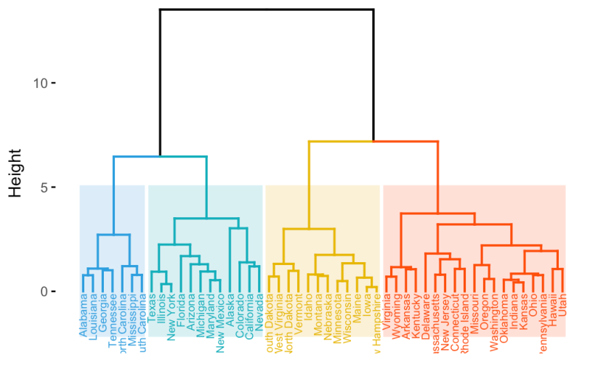
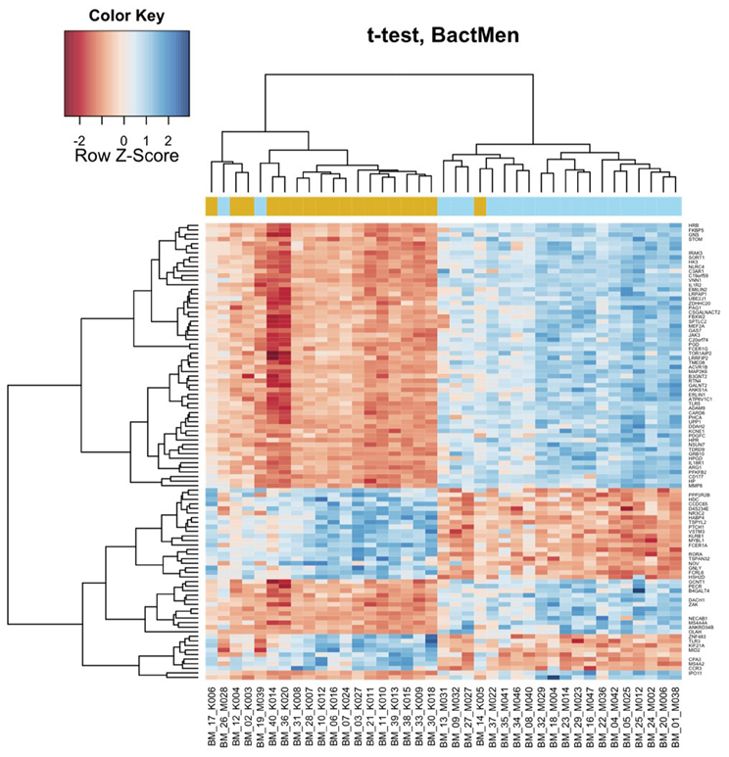
Hierarchical Clustering
HC produces a dendrogram.
Each data item is a leaf.
The height of the bars indicates how close the items are.
A heatmap allows a clear visualization of expression values associated to clusters.
Two-way hierarchical clustering is carried out for both samples and genes. These are given at the sides of the heatmap to facilitate visualization.

Slide 39
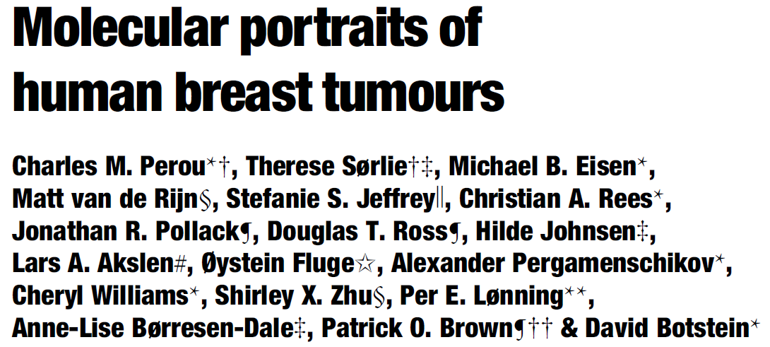
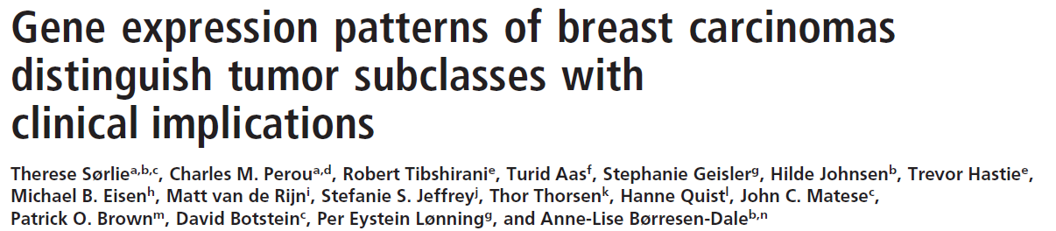
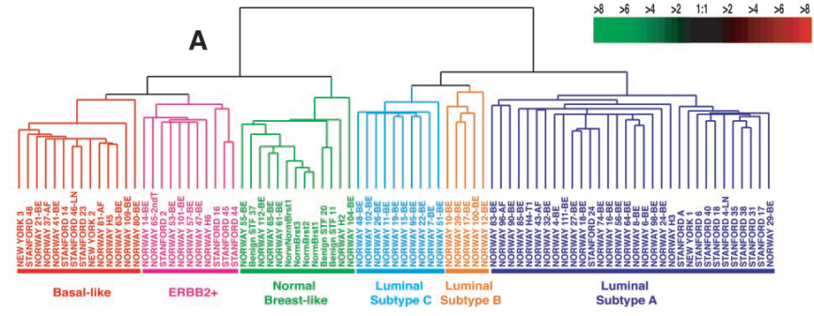
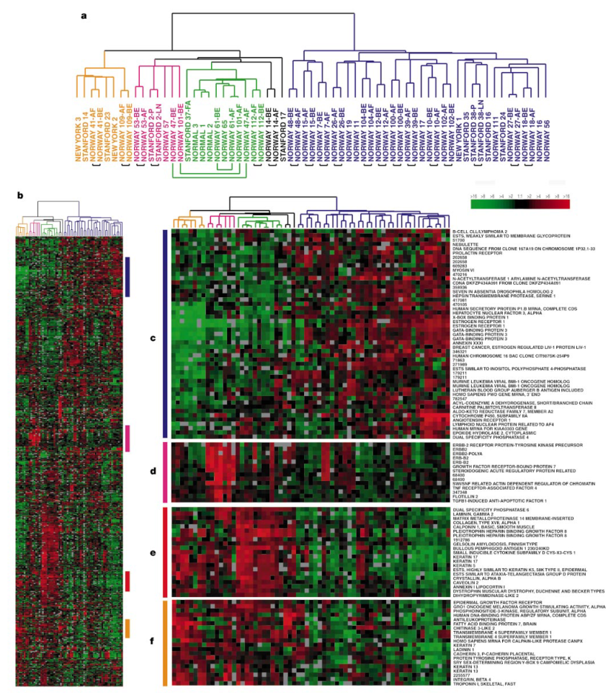
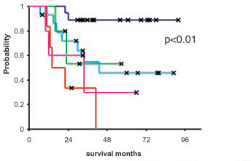
Class discovery: example on breast cancer

Slide 40
Class prediction
Goal: classify a sample in a predefined class according to an a priori scheme
Learning from examples, classification
We have already seen groups of healthy and sick people. Now let’s diagnose the next person walking into the hospital.
We identified breast cancer subtypes in a cohort of patients. Now let’s assign a new breast cancer patient coming to the hospital to one of these classes
Many agorithms based on machine learning and artificial intelligence

Slide 41
Class prediction: general approach
Training set
Data: microarrays
Labels: for each one we know if it falls into our class of interest or not (binary classification)
New data (test data)
Data for which we don’t have labels.
E.g.: New patient without label
Goal: Generalization ability
Build a classifier from the training data that is good at predicting the right class for the new data.

Slide 42
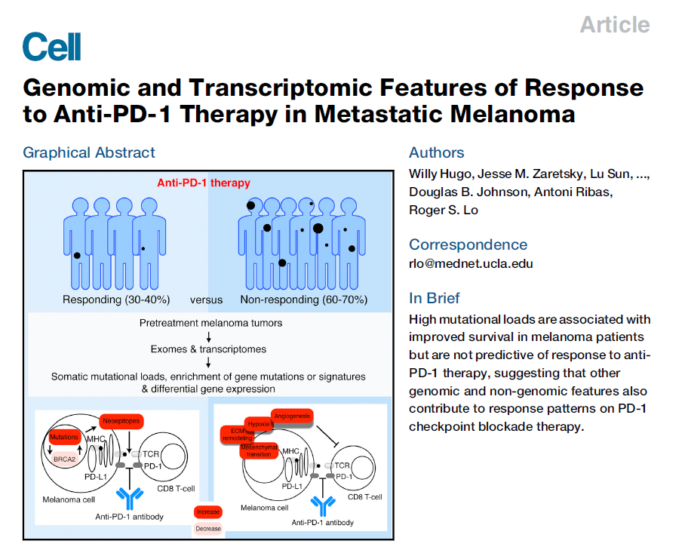
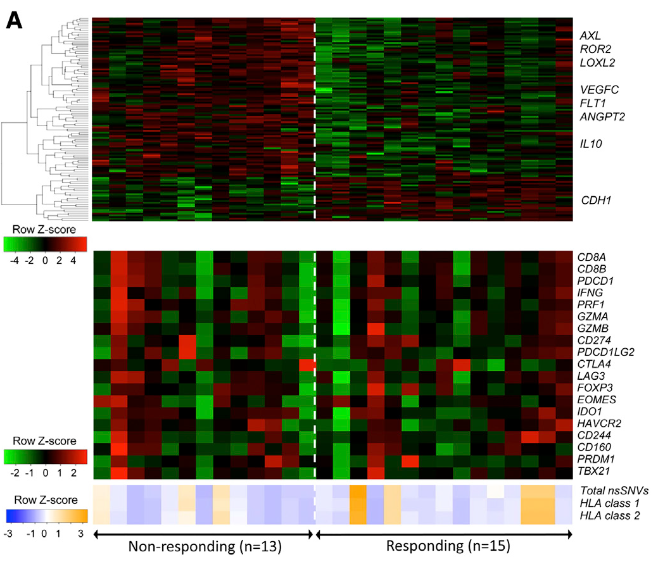
Class comparison
Differentially expressed genes in the pre-treatment tumors derived from patients who responded versus who did not respond to anti-PD-1 treatment

Slide 43
Size of effect – log fold change
Given two different sets of samples (e.g. Reponder and Non-responder), differences between these samples for a gene can be measured in terms of:
E_{gene1} _{Responder}
2^{-△△Ct}
Fold Change_{gene1} =
E_{gene1} _{Non-responder}
or
Log(E)_{gene1} _{Responder} – Log(E)_{gene1} _{Non-responder}
Log(Fold Change)_{gene1} =
-△△Ct

Slide 44
Statistical significance: p-value
The statistical significance answer the question: “Are we confident that there is a real difference?”
P-value: probability to observe a difference equal or greater than the observed one, by chance.
GENE 1
GENE 2
Expression value
Expression value
NR
R
NR
R
SIGNIFICANT
NOT SIGNIFICANT

Slide 45
Statistical significance: multiple testing correction
Why Multiple Testing Matters
Genomics = Lots of Data = Lots of Hypothesis Tests
A typical microarray experiment might result in performing 10000 separate hypothesis tests.
If we use a standard p-value cut-off of 0.05, we would expect 500 genes to be deemed “significant” by chance.
Multiple testing correction adjusts the individual p-value for each gene to keep the overall error rate to less than or equal to the user-specified p-cutoff value.

Slide 46
Statistical significance: multiple testing correction
Bonferroni
Bonferroni Step-down
Westfall and Young Permutation
Benjamini and Hochberg False Discovery Rate
STRINGENCY

Slide 47
Statistical significance: multiple testing correction
Examples
Bonferroni correction
Take the p-value of each gene and multiply it by the number of genes in the gene list. If the corrected p-value is still below the cutoff, the gene will be significant:
Corrected P-value = p-value * n (number of genes in test) < 0.05
Rank | Gene | P-value
1 | A | 0.00002
2 | B | 0.00004
3 | C | 0.00009
Correction:
Gene A adj. p-value = 0.00002 * 1000 = 0.02 < 0.05 → gene is significant
Gene B adj. p-value = 0.00004 * 1000 = 0.04 < 0.05 → gene is significant
Gene C adj. p-value = 0.00009 * 1000 = 0.09 > 0.05 → gene is not significant

Slide 48
Statistical significance: multiple testing correction
Examples
Benjamini & Hochberg False Discovery Rate
This correction is the least stringent of all 4 options. Here is how it works:
1) Rank the p-value of each gene in order from the smallest to the largest.
2) Each p-value is multiplied by the number of tests divided by the rank of the gene
Rank | Gene | P-value
1 | A | 0.00002
2 | B | 0.00004
3 | C | 0.00009
Correction:
Gene A adj. p-value = 0.00002 * 1000/1 = 0.02 < 0.05 → gene is significant
Gene B adj. p-value = 0.00004 * 1000/2 = 0.02 < 0.05 → gene is significant
Gene C adj. p-value = 0.00009 * 1000/3 = 0.03 < 0.05 → gene is significant

Slide 49
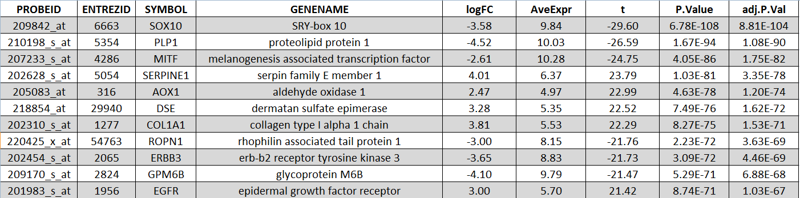
Output of differential expression analysis
.
.
.
.
.
.
.
.
.
.
.
.
.
.
.
.
.
.
.
.
.
.
.
.
.
.
.
.
.
.
.
.
.
.
.
.

Slide 50
Homework
Two gene expression datasets are provided in excel format at the following link: https://www.dropbox.com/sh/7m1syyg95n6d8ng/AACw8WcTDB4qMQFY9aWfD2IJa?dl=0
Expression_dataset_example_1.xlsx: gene expression profiles of a melanoma cell line resistant to BRAF inhibitors compared to the parental sensitive counterpart
Expression_dataset_example_2.xlsx: gene expression profiles of matched pre- and post-treatment melanoma metastasis from 4 patients treated with BRAF inhibitors (PAY ATTENTION, paired design!)
For each gene calculate the log fold change (logFC), the p-value (use t-test), the Bonferroni adjusted p-value and the Benjamini-Hochberg false discovery rate (FDR). All these calculations can be made using excel formulas.
For each dataset apply filters to select differentially expressed genes and complete the following table:
 | Dataset 1 |  |  | Dataset 2
 | P-value < 0.05 | Bonferroni p-value < 0.05 | FDR < 0.05 | P-value < 0.05 | Bonferroni p-value < 0.05 | FDR < 0.05
Up-regulated (logFC > 1)
Down-regulated (logFC < -1)

